Slide 1
M.Tech.(AIML) Introduction to Statistical Methods
Team ISM

Slide 2
Session No 3
Introduction to Conditional Probability, independent events, Total Probability
(Session 3: 26th/27th Nov 2022)

Slide 3
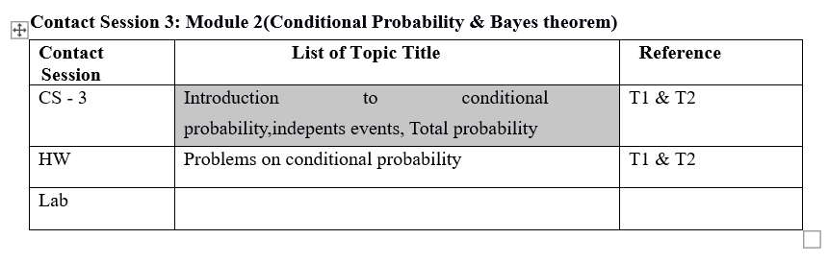
Contact Session 3

Slide 4
Agenda
Conditional Probability
Independent events
Total Probability
Text Books
No | Author(s), Title, Edition, Publishing House
T1 | Statistics for Data Scientists, An introduction to probability, statistics and Data Analysis, Maurits Kaptein et al, Springer 2022
T2 | Probability and Statistics for Engineering and Sciences, 8th Edition, Jay L Devore, Cengage Learning

Slide 5
CONDITIONAL PROBABILITY
The probabilities assigned to various events depend on what is known about the experimental situation when the assignment is made. Subsequent to the initial assignment, partial information relevant to the outcome of the experiment may become available. Such information may cause us to revise some of our probability assignments

Slide 6
CONDITIONAL PROBABILITY
We examine how the information “an event B has occurred” affects the probability assigned to A. For example, A might refer to an individual having a particular disease in the presence of certain symptoms. If a blood test is performed on the individual and the result is negative , then the probability of having the disease will change (it should decrease, but not usually to zero, since blood tests are not infallible). We will use the notation to represent the conditional probability of A given that the event B has occurred. B is the “conditioning event.”

Slide 7
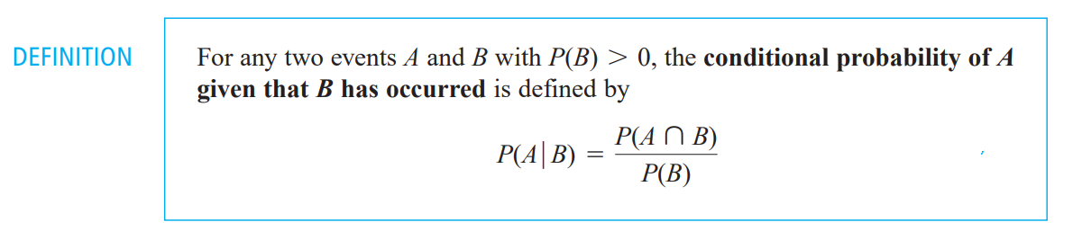
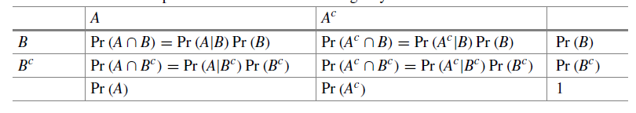
CONDITIONAL PROBABILITY
Conditional probabilities in a 2 × 2 contingency table

Slide 8
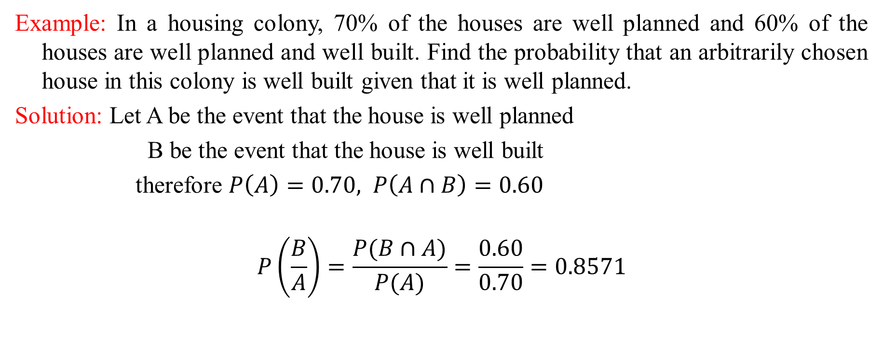
Examples on Conditional Probability
Example: In a housing colony, 70% of the houses are well planned and 60% of the houses are well planned and well built. Find the probability that an arbitrarily chosen house in this colony is well built given that it is well planned.
Solution: Let A be the event that the house is well planned
B be the event that the house is well built
therefore $P\left(A\right)=0.70, P\left(A∩B\right)=0.60$
$$P\left(\frac{B}{A}\right)=\frac{P(B∩A)}{P(A)}=\frac{0.60}{0.70}=0.8571$$

Slide 9

CONDITIONAL PROBABILITY
Example:
If the probability that a communication system will have high fidelity is 0.81 and the probability that it will have high fidelity and high selectivity is 0.18, what is probability that a system with high fidelity will also have high selectivity?
Solution:
If 𝐴 is the event that a communication system has high selectivity and 𝐵 is the event that it has high fidelity, we have 𝑃(𝐵)=0.81 and 𝑃(𝐴∩𝐵)=0.18, and substitution into the formula yields

Slide 10


CONDITIONAL PROBABILITY
Example:
Suppose that of all individuals buying a certain digital camera, 60% include an optional memory card in their purchase, 40% include an extra battery, and 30% include both a card and battery.
Given that the randomly selected individual purchased an extra battery, find the probability that an optional card was also purchased.
Given that the randomly selected individual purchased an optional card, find the probability that an extra battery was also purchased.
Solution:
let𝐴={ memory card purchased } and 𝐵={ battery purchased }. Then 𝑃(𝐴)=.60,𝑃(𝐵)=.40,
and 𝑃( both purchased )=𝑃(𝐴∩𝐵)=.30.
a) b)
Notice that 𝑃(𝐴∣𝐵)≠𝑃(𝐴) and 𝑃(𝐵∣𝐴)≠𝑃(𝐵).

Slide 11
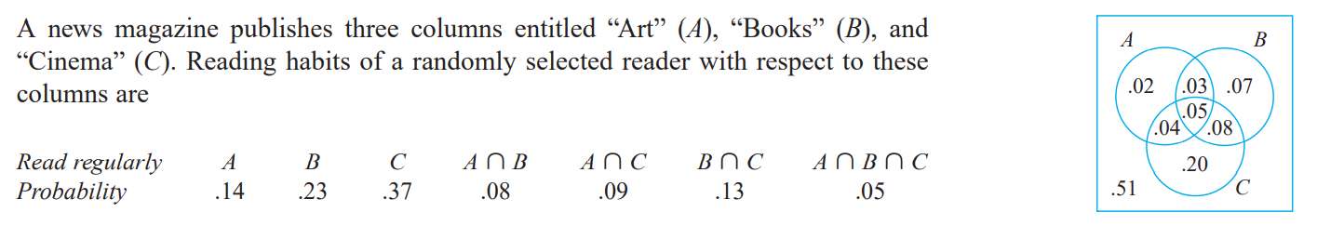
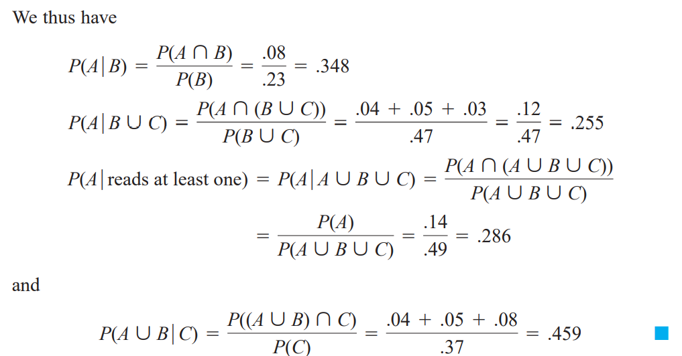
Example:
Find P(A/B), P(A/BUC), P(A/ reads at least one)
Solution:

Slide 12
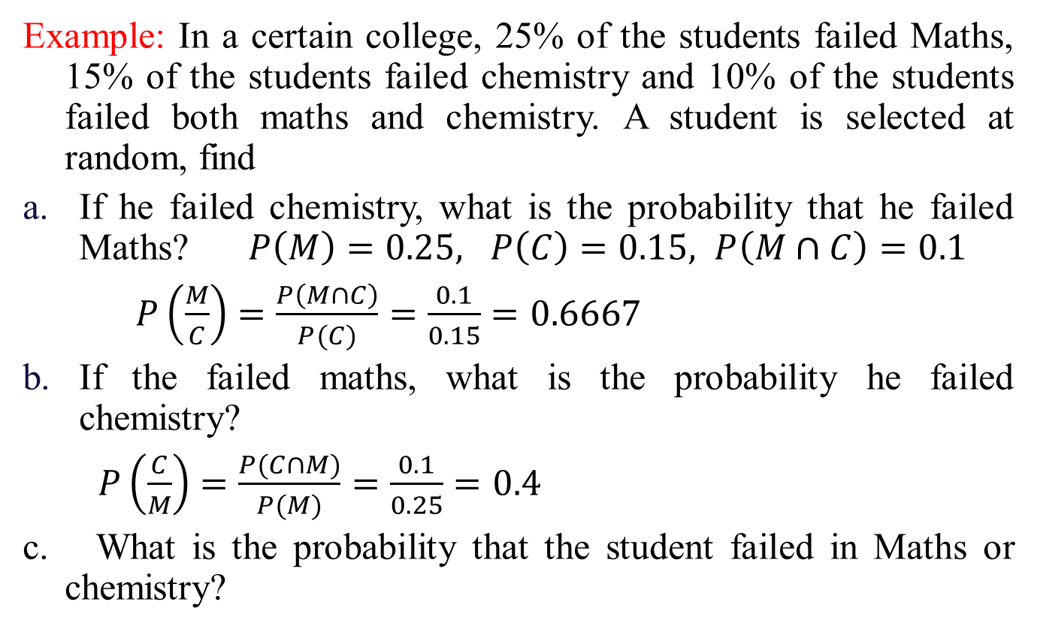
Examples on Conditional Probability
Example: In a certain college, 25% of the students failed Maths, 15% of the students failed chemistry and 10% of the students failed both maths and chemistry. A student is selected at random, find
If he failed chemistry, what is the probability that he failed Maths? $P\left(M\right)=0.25, P\left(C\right)=0.15, P\left(M∩C\right)=0.1$
$P\left(\frac{M}{C}\right)=\frac{P\left(M∩C\right)}{P(C)}=\frac{0.1}{0.15}=0.6667$
If the failed maths, what is the probability he failed chemistry?
$P\left(\frac{C}{M}\right)=\frac{P(C∩M)}{P(M)}=\frac{0.1}{0.25}=0.4$
c. What is the probability that the student failed in Maths or chemistry?

Slide 13
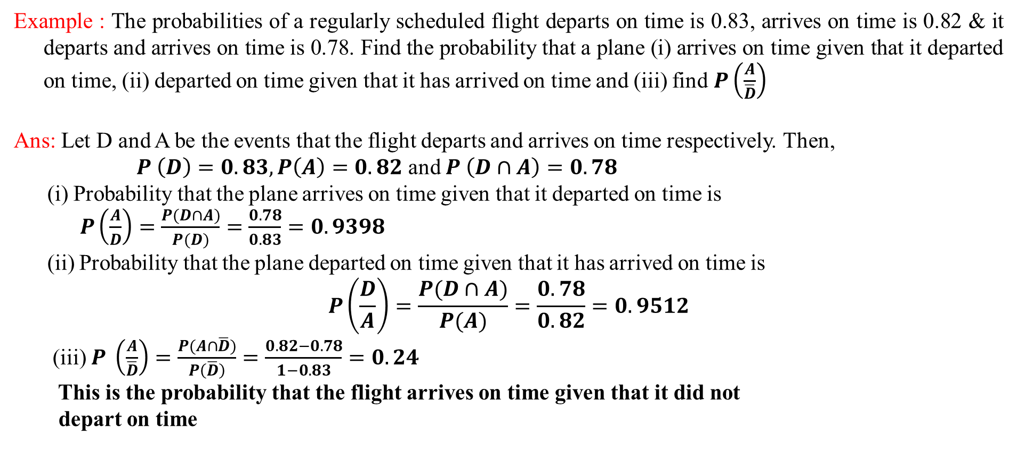
Examples on Conditional Probability
Example : The probabilities of a regularly scheduled flight departs on time is 0.83, arrives on time is 0.82 & it departs and arrives on time is 0.78. Find the probability that a plane (i) arrives on time given that it departed on time, (ii) departed on time given that it has arrived on time and (iii) find $P\left(\frac{A}{\overline{D}}\right)$
Ans: Let D and A be the events that the flight departs and arrives on time respectively. Then,
$P \left(D\right)=0.83, P\left(A\right)=0.82$ and $P \left(D∩A\right)=0.78$
(i) Probability that the plane arrives on time given that it departed on time is
$P\left(\frac{A}{D}\right)=\frac{P(D∩A)}{P(D)}=\frac{0.78}{0.83}=0.9398$
(ii) Probability that the plane departed on time given that it has arrived on time is
$$P\left(\frac{D}{A}\right)=\frac{P(D∩A)}{P(A)}=\frac{0.78}{0.82}=0.9512$$
(iii) $P \left(\frac{A}{\overline{D}}\right)=\frac{P(A∩\overline{D})}{P\left(\overline{D}\right)}=\frac{0.82−0.78}{1−0.83}=0.24$
This is the probability that the flight arrives on time given that it did not
depart on time

Slide 14
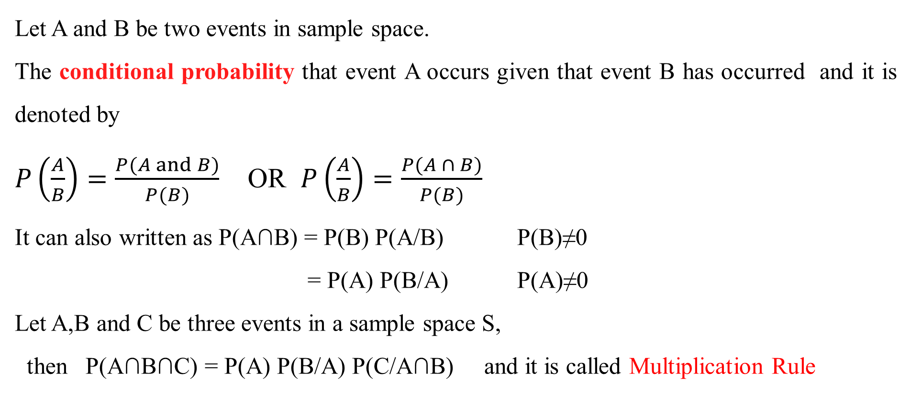
CONDITIONAL PROBABILITY
Multiplication Rule
Let A and B be two events in sample space.
The conditional probability that event A occurs given that event B has occurred and it is denoted by
$P\left(\frac{A}{B}\right)=\frac{P(A and B)}{P(B)}$ OR $P\left(\frac{A}{B}\right)=\frac{P(A ∩ B)}{P(B)}$
It can also written as P(A∩B) = P(B) P(A/B) P(B)≠0
= P(A) P(B/A) P(A)≠0
Let A,B and C be three events in a sample space S,
then P(A∩B∩C) = P(A) P(B/A) P(C/A∩B) and it is called Multiplication Rule

Slide 15
CONDITIONAL PROBABILITY
Multiplication Rule
In general, A₁,A₂,…….A_{n} are events in S, then
P(A₁∩A₂∩…. ∩A_{n}) = P(A₁) P(A₂/A₁)P(A₃/A₁∩A₂)
……P(A_{n}/A₁ ∩A₂ ∩…… ∩A_{n-1})

Slide 16
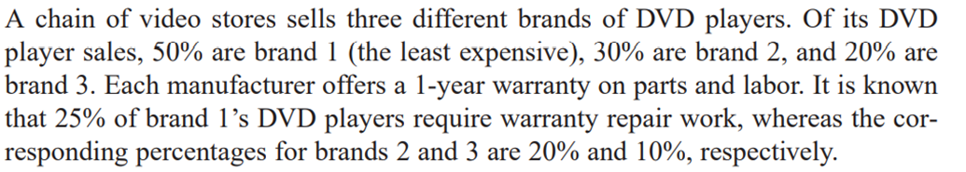
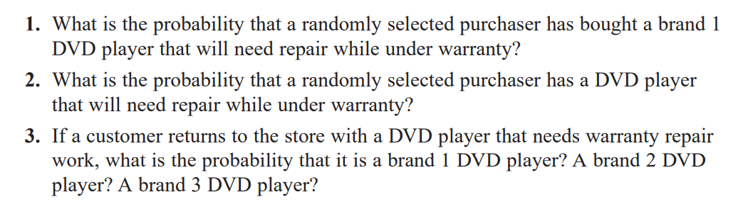

Slide 17
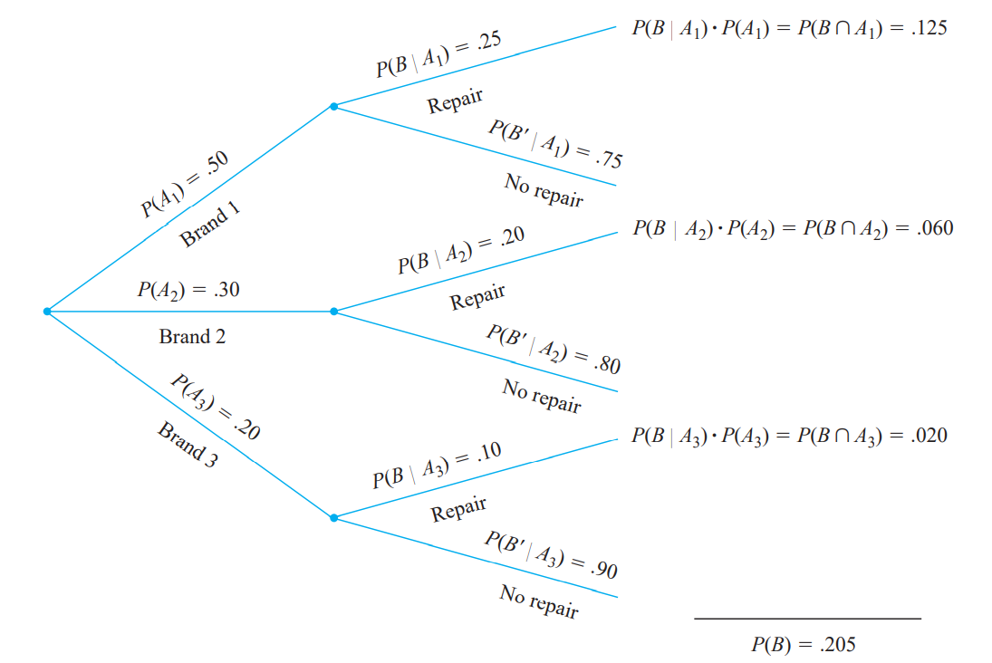

Slide 18
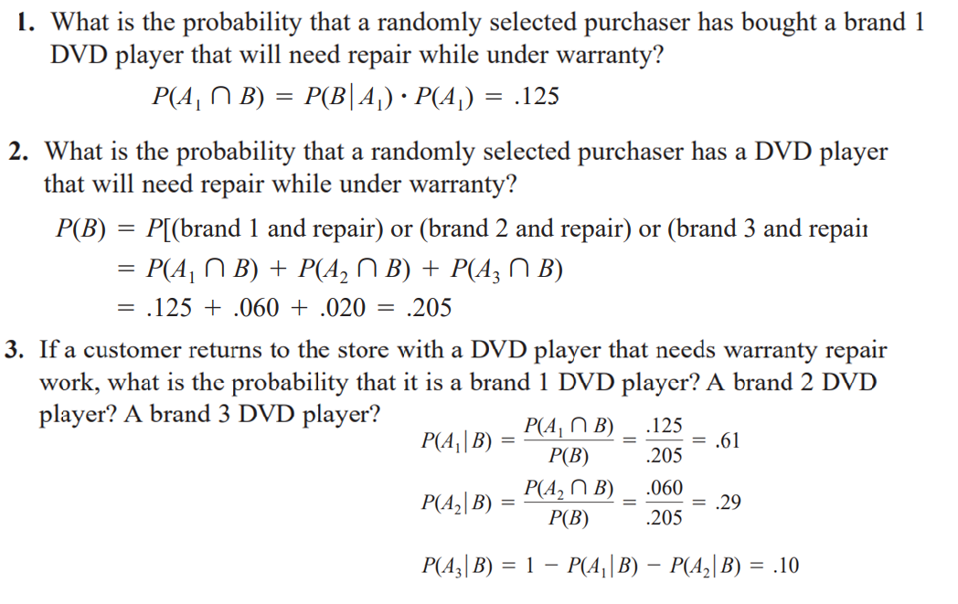

Slide 19
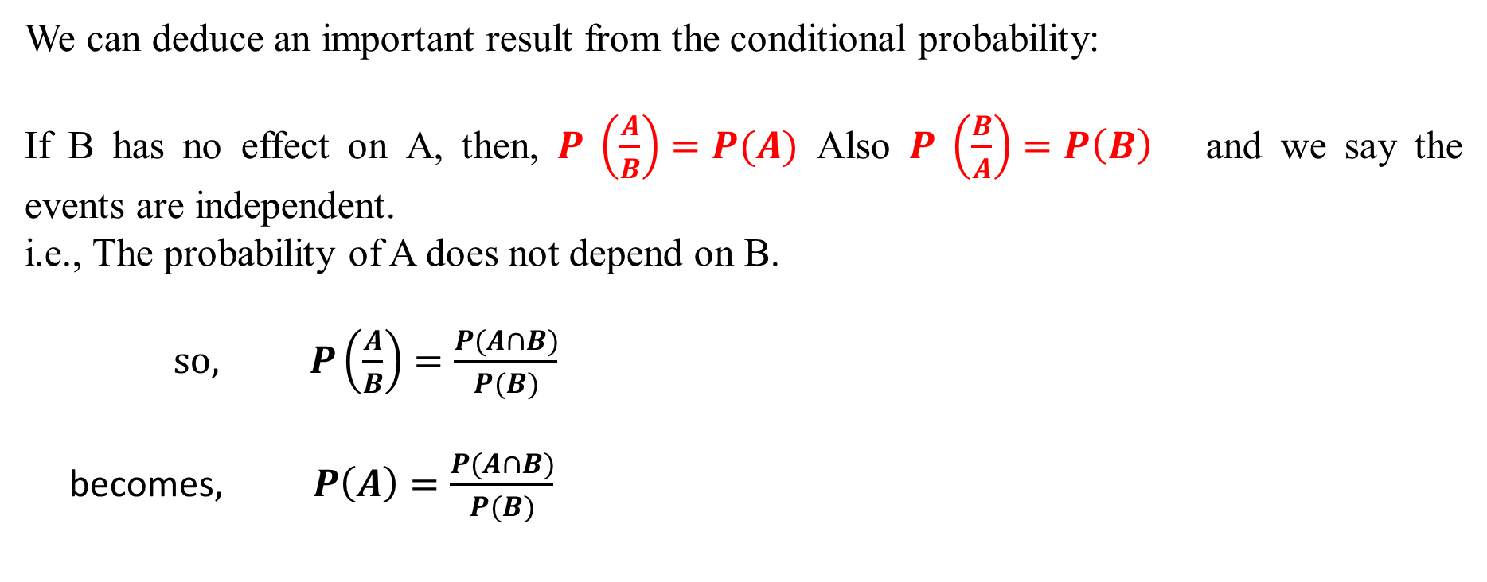
INDEPENDENT EVENTS
We can deduce an important result from the conditional probability:
If B has no effect on A, then, $P \left(\frac{A}{B}\right)=P(A)$ Also $P \left(\frac{B}{A}\right)=P\left(B\right)$ and we say the events are independent.
i.e., The probability of A does not depend on B.
$so, P\left(\frac{A}{B}\right)=\frac{P(A∩B)}{P(B)}$
becomes$, P\left(A\right)=\frac{P(A∩B)}{P(B)}$
or P(A ∩ B) = P(A) × P(B)

Slide 20
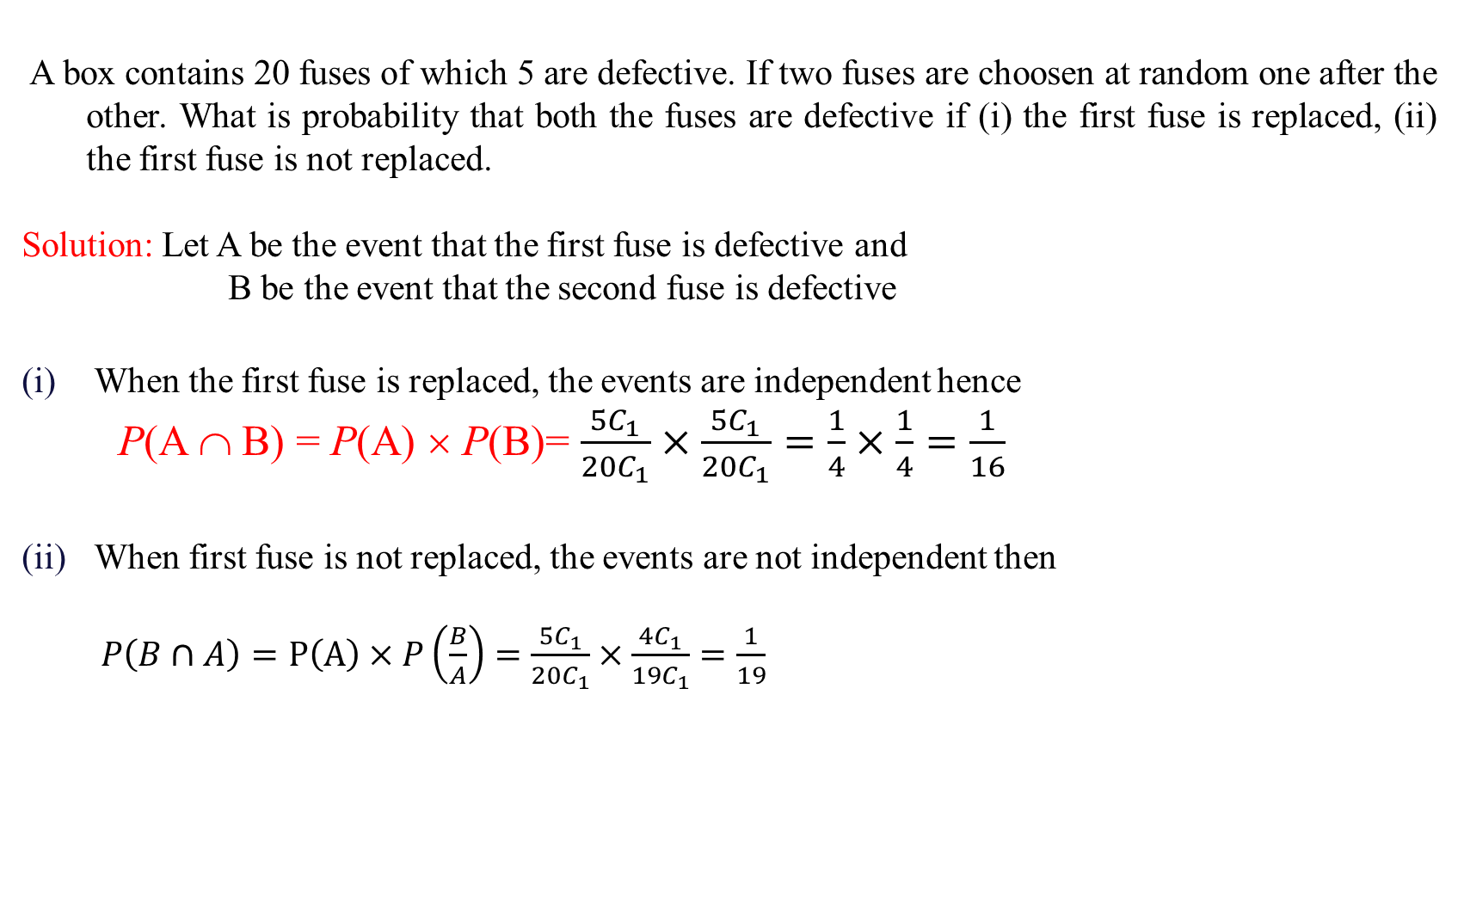
Examples on Independent Events
A box contains 20 fuses of which 5 are defective. If two fuses are choosen at random one after the other. What is probability that both the fuses are defective if (i) the first fuse is replaced, (ii) the first fuse is not replaced.
Solution: Let A be the event that the first fuse is defective and
B be the event that the second fuse is defective
When the first fuse is replaced, the events are independent hence
P(A ∩ B) = P(A) × P(B)= $\frac{5C_{1}}{20C_{1}}×\frac{5C_{1}}{20C_{1}}=\frac{1}{4}×\frac{1}{4}=\frac{1}{16}$
When first fuse is not replaced, the events are not independent then
$P\left(B∩A\right)=P\left(A\right)×P\left(\frac{B}{A}\right)=\frac{5C_{1}}{20C_{1}}×\frac{4C_{1}}{19C_{1}}=\frac{1}{19}$

Slide 21
Examples on Independent Events
A problem in statistics is given to 3 students A,B,C. Their chances of solving it are 1/2,1/3/,1/4. Find the probability that the problem is solved.
Solution: Problem can be solved by either A or B or C
Therefore we have to use
P(AUBUC) = P(A) + P(B) + P(C) - P(A∩B) - P(B∩C) - P(A∩C) + P(A ∩ B ∩ C)
Using complement of the event i.e the problem is not solved . Therefore P(problem solved is )=1-P(not solved)
Note: If A, B,C are independent
then

Slide 22
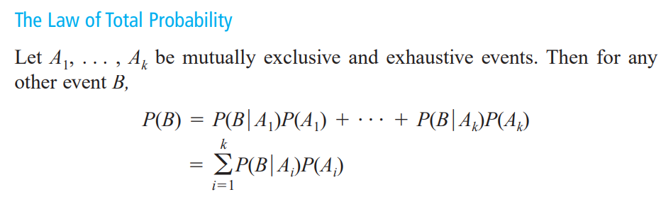

Slide 23








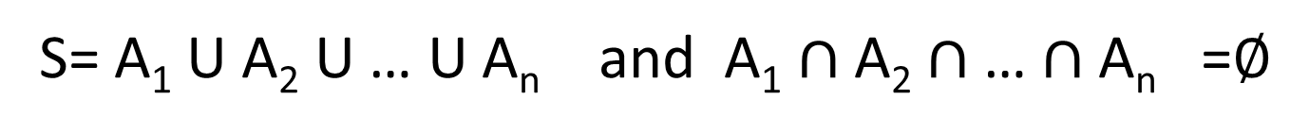
S= A₁ U A₂ U … U A_{n} and A₁ $∩$ A₂ $∩$ … $∩$ A_{n} =$∅$
B
$$A_{5}$$
S
$$A_{1}$$
$$A_{3}$$
$$A_{4}$$
$$A_{6}$$
$$A_{2}$$
$$A_{k}$$

Slide 24
Proof:
We have
Using distributive law in the R.H.S, we get
Since B ∩ A_{i} (i = 1 to n) are mutually exclusive, we have by applying addition rule of probability,
Using multiplication rule on each term on R.H.S, namely
(1)
(2)-Total theorem on Probability

Slide 25

The Theorem of Total Probability
(tree diagram )
B
A₁
A₂
A₃
A_{k}

Slide 26
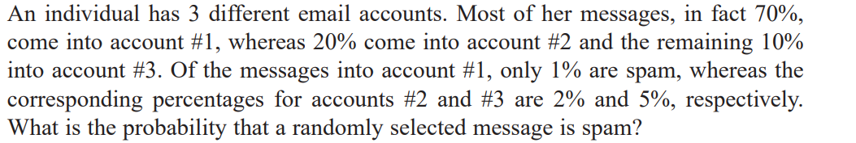
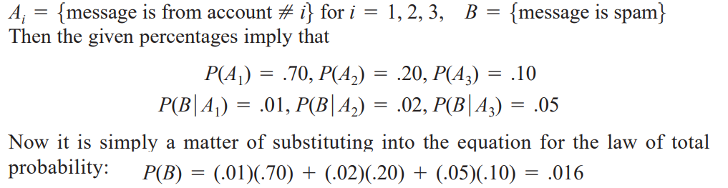
Law of Total Probability

Slide 27
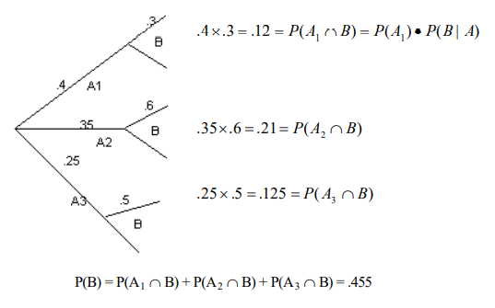
Law of Total Probability
At a certain gas station, 40% of the customers use regular gas (A1), 35% use plus gas (A2), and 25% use premium (A3). Of those customers using regular gas, only 30% fill their tanks (event B). Of those customers using plus, 60% fill their tanks, whereas of those using premium, 50% fill their tanks. What is the probability that the next customer fills the tank?

Slide 28
Law of Total Probability
A company that manufactures video cameras produces a basic model and a deluxe model. Over the past year, 40% of the cameras sold have been of the basic model. Of those buying the basic model, 30% purchase an extended warranty, whereas 50% of all deluxe purchasers do so. What is the probability that that a randomly selected purchaser has an extended warranty?

Slide 29
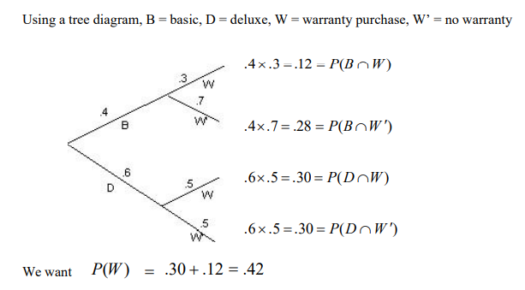

Slide 30
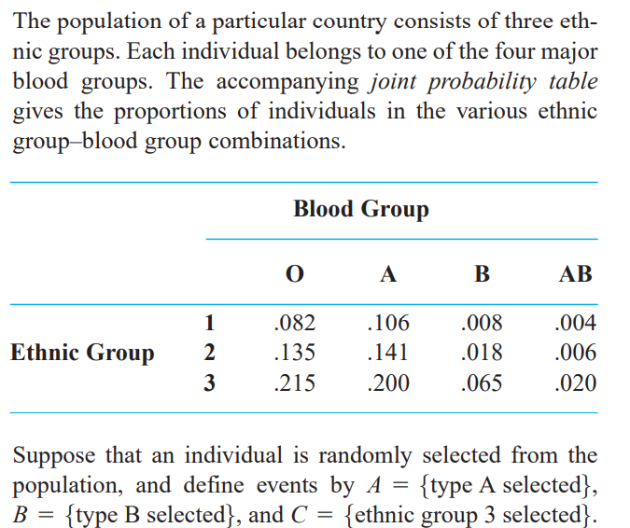
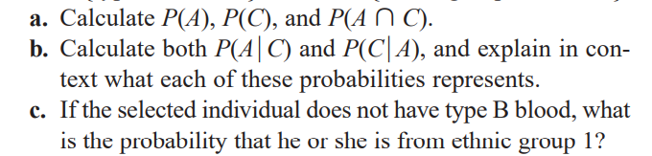
HW: Exercise

Slide 31
HW: Exercise
If A and B are two events with P(A)= ½, P(B)= 1/3 and
Find

Slide 32
HW: Exercise
One card is randomly collected from the deck of 52 cards.
What is the probability that this card is a heart?
What is the probability that this card is not a heart?
What is the probability that it is a heart and a king?
What is the probability that the card is a heart or a king?
Are the events that the card is a heart and is a king independent?

Slide 33
HW: Exercise
A card is randomly drawn from an incomplete deck of cards from which the ace
of diamonds is missing.
1. What is the probability that the card is “clubs”?
2. What is the probability that the card is a “queen”?
3. Are the events “clubs” and “queen” independent?

Slide 34
HW: Exercise
In a group of children from primary school there are 18 girls and 15 boys. Of
the girls, 9 have had measles. Of the boys, 6 have had measles.
1. What is the probability that a randomly chosen child from this group has had
measles?
2. If we randomly choose one person from the group of 18 girls, what is the
probability that this girl has had measles?
3. Are the events “boy” and “measles” in this example independent?

Slide 35
HW: Exercise
In a Japanese cohort study, 5,322 male non-smokers and 7,019 male smokers
were followed for four years. Of these men, 16 non-smokers and 77 smokers developed lung cancer.
1. What is the probability that a randomly chosen non-smoker from this group
developed lung cancer?
2. What is the probability that a randomly chosen smoker from this group developed
lung cancer?
3. Are the events “smoking” and “lung cancer” in this example independent?
4. What is the conditional probability that the patient is a smoker if he has developed
lung cancer?

Slide 36
Thanks

